Slide 2
Chairman nr 1 - JAAN LATTIK 1956-1963

Slide 3
Ambassador Heinrich Laretei & others

Slide 4
Hej minister Edman! We want to establish Estonian Schools

Slide 5
The seniors were serious

Slide 6
The younger ones had fun

Slide 7
Smoking in auditorium was norm

Slide 8
Lotteri will solv the financial problems

Slide 9
Nr. 2 HANS KAURI 1963-1967

Slide 10
Jüri Lossman: 20 years in Sweden! Let`s make a present to the King …

Slide 11
GIMO Democracy School

Slide 12
Nr. 3 LEO KARUPÄÄ 1967-74
The man who loved to smoke his pipe

Slide 13
Do they play poker?

Slide 14
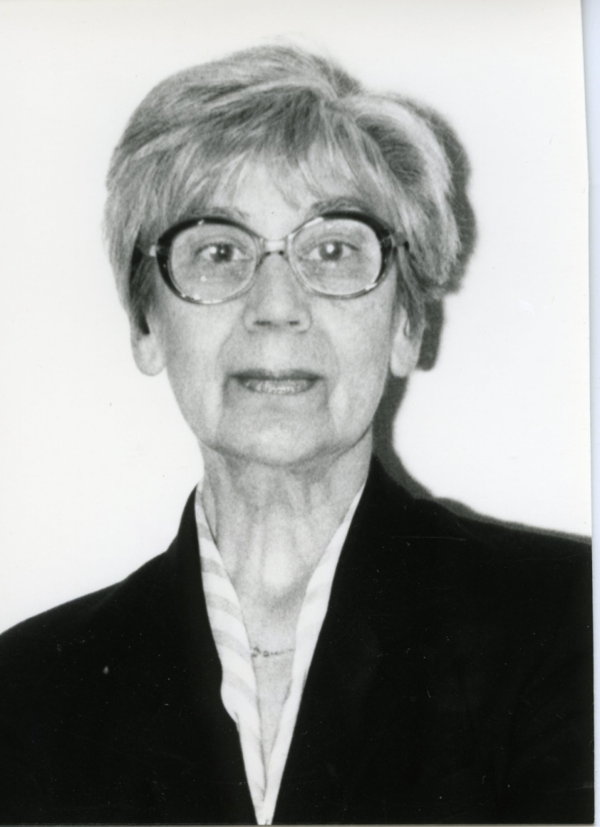
Ahti Pae & Mai Raud-Pähn

Slide 15
Jackpot: VOLVO Amazone

Slide 16
What´s going on?
1974 nr. 4 Olaf Muruk
1974-1975 nr. 5 Hans Kauri
1975-1977 nr. 6 Olaf Muruk
1977-1979 nr. 7 Hans Kauri

Slide 17
Congress of organisations every 4th year

Slide 18
Anniversary of the Estonian Republic which doesn´t exists on the map

Slide 19
Ahti Pae: Children, who was Jaan Tõnisson?

Slide 20
Nr 8 JAAN VILVAL 1979-83

Slide 21
A lot of paperwork

Slide 22
Nr 9 JOHAN HAABMA 1983-1991

Slide 23
Nr 10 PEETER LUKSEP(1991-2003)

Slide 24
Honourable men: Tillu Hanson, Rein Asu, Peeter Luksep

Slide 25
Leelo Pukk with Baltic friends

Slide 26
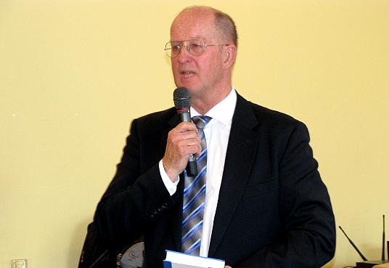
Nr 11 AHO REBAS (2003-2006)

Slide 27
Nr 12 JAAK AKKER (2006-2012)

Slide 28
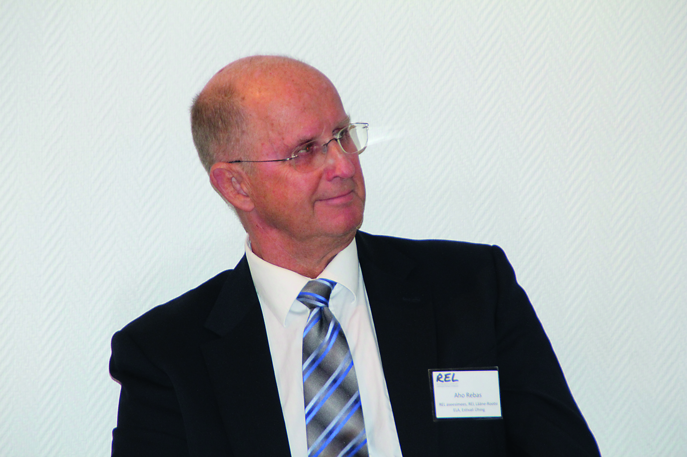
Stormy winds
2012 nr. 13 Egert Lemmik (Särel)
2012-2013 Aho Rebas

Slide 29
Nr. 15 SIRLE SÖÖT (2013-…)

Slide 31
#STOPNORDSTREAM2

Slide 32
REL as a beehive

