Slide 1
The President Elections in Estonia
2016-10-11
Sirle Sööt

Slide 2
Legal ground
Constitution of the Republic of Estonia § 79
President of the Republic Election Act

Slide 3
Who can be nominated?
Estonian citizen by birth
attained 40 years of age
RESTRICTIONS:
A person who is serving as President of the Republic for a 2nd consecutive term
A person in active service in the Defence Forces.

Slide 4
Who can nominate ?
not less than 1/5 of the membership of the Riigikogu (21 members).
A member of the Riigikogu may nominate only one candidate.

Slide 5
Who elects the President?
Riigikogu
if the Riigikogu fails to elect the President
Electoral body
The electoral body:
members of the Riigikogu (101)
representatives of the local government councils (234)

Slide 6
Electoral Body
Based on the number of citizens entered in the Estonian National Electoral Register of Citizens in the administrative territory of a local government on 1 January of the president election year
The number of local government council representatives:
up to 10,000 Est citizens with the right to vote – 1
10,001–50,000 /…/ – 2;
50,001-100,000 /…/ – 4;
more than 100,000 /…/ – 10

Slide 7
Who organise the president elections?
The National Electoral Committee
A sitting shall be chaired by the President or Vice-President of the Riigikogu.

Slide 8
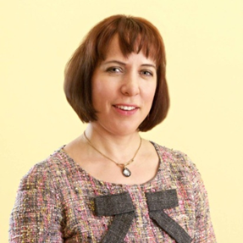
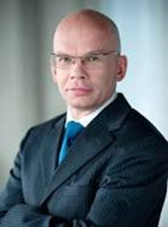
First round of voting in Riigikogu- 29 August
Eiki Nestor (63) Mailis Reps (41) Allar Jõks (51) empty ballot papers
40 votes 26 votes 25 votes 8
The candidate in favour of whom a two-thirds majority of the membership of the Riigikogu votes (68) shall be considered elected.

Slide 9
Second round of voting in Riigikogu – 30 August
Siim Kallas (68) Mailis Reps (41) Allar Jõks (51) empty ballot papers
45 votes 32 votes 21 votes 1
The candidate in favour of whom a two-thirds majority of the membership of the Riigikogu votes (68) shall be considered elected.

Slide 10
Third round of voting in Riigikogu 30 August
Siim Kallas (68) Mailis Reps (41)
42 votes 26 votes
The candidate in favour of whom a 2/3 majority of the membership of the Riigikogu votes (68) shall be considered elected.
empty ballot papers
30

Slide 11
First round of voting in electoral body
Electoral body: representatives of the local government councils (234) + MP of the Riigikogu (101)
Tallinn 10 Viimsi rural municipality 2
Tartu 4 Rakvere 2
Pärnu 2 Kuressaare 2
Narva 2 Võru 2
Kohtla-Järve 2 Rae rural municipality 2
Viljandi 2 Other municipalities (202) 1

Slide 12
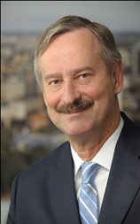
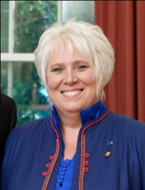
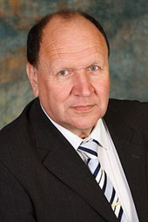
First round of voting in electoral body- 24 September
Allar Jõks, Siim Kallas, Mailis Reps, Marina Kaljurand, Mart Helme
83 votes 81 votes 79 votes 75 votes 16 votes
The candidate in favour of whom votes a majority of the members of the electoral body participating in the voting (50% + 1 vote =168 votes) shall be considered elected.

Slide 13
Second round of voting in electoral body – 24 September
Siim Kallas Allar Jõks
138 votes 134 votes
The candidate in favour of whom votes a majority of the members of the electoral body participating in the voting (50% + 1 vote =167 votes) shall be considered elected.
empty ballot papers
57

Slide 14
Extraordinary election
If no candidate receives the required majority, the election of the President of the Republic shall be held pursuant to clause 3 (2) 3) of this Act. (§ 26 lg 3 President of the Republic Election Act)
An extraordinary election shall be held within 14 days after the date the electoral body fails to elect the President. (§ 3 lg 2 p 3)

Slide 15
An extraordinary election in the Riigikogu- 3 October
Kersti Kaljulaid (46)
81 votes
The candidate in favour of whom a two-thirds majority of the membership of the Riigikogu votes (68 votes) shall be considered elected
empty ballot papers
17

Slide 16
Congratulations!
Electoral Committee announces Kersti Kaljulaid to the President according to the § 13 lg 2

